Slide 1
Breadth First Search

Slide 2
EXAMPLE
Root
Depth 0
Depth 1
Depth 2
Depth 3

Slide 3
BFS
Root
1
Depth 0
2
3
4
Depth 1
5
6
7
8
Depth 2
9
10
11
12
13
14
Depth 3

Slide 4
EXAMPLE
1
Root

Slide 5
EXAMPLE
6
7
2
3
1
1
Root
Root
4
5
8
9

Slide 6
IMPLEMENTATION USING A QUEUE
FIFO
First In First Out

Slide 7
IMPLEMENTATION USING A QUEUE
Root
1
1

Slide 8
IMPLEMENTATION USING A QUEUE
Root
4
3
2
1
1
2
3
4

Slide 9
IMPLEMENTATION USING A QUEUE
Root
6
5
4
3
1
1
2
2
3
4
5
6

Slide 10
IMPLEMENTATION USING A QUEUE
Root
6
5
4
1
1
2
3
2
3
4
5
6
7
9

Slide 11
IMPLEMENTATION USING A QUEUE
Root
8
7
6
5
1
1
2
3
2
3
4
4
5
6
7
8

Slide 12
IMPLEMENTATION USING A QUEUE
Root
10
9
8
7
6
1
1
2
3
2
3
4
4
5
5
6
7
8
9
10

Slide 13
IMPLEMENTATION USING A QUEUE
Root
10
9
8
7
1
1
2
3
2
3
4
4
5
6
5
6
7
8
9
10

Slide 14
IMPLEMENTATION USING A QUEUE
Root
12
11
10
9
8
1
1
2
3
2
3
4
4
5
6
5
6
7
8
7
9
10
11
12

Slide 15
IMPLEMENTATION USING A QUEUE
Root
14
13
12
11
10
9
1
1
2
3
2
3
4
4
5
6
5
6
7
8
7
8
9
10
11
12
13
14

Slide 16
IMPLEMENTATION USING A QUEUE
Root
14
13
12
11
10
1
1
2
3
2
3
4
4
5
6
5
6
7
8
7
8
9
9
10
11
12
13
14

Slide 17
IMPLEMENTATION USING A QUEUE
Root
14
13
12
11
1
1
2
3
2
3
4
4
5
6
5
6
7
8
7
8
9
10
9
10
11
12
13
14

Slide 18
IMPLEMENTATION USING A QUEUE
Root
14
13
12
1
1
2
3
2
3
4
4
5
6
5
6
7
8
7
8
9
10
9
10
11
12
13
14
11

Slide 19
IMPLEMENTATION USING A QUEUE
Root
14
13
1
1
2
3
2
3
4
4
5
6
5
6
7
8
7
8
9
10
9
10
11
12
13
14
11
12

Slide 20
IMPLEMENTATION USING A QUEUE
Root
14
1
1
2
3
2
3
4
4
5
6
5
6
7
8
7
8
9
10
9
10
11
12
13
14
11
12
13

Slide 21
IMPLEMENTATION USING A QUEUE
Root
1
1
2
3
2
3
4
4
5
6
5
6
7
8
7
8
9
10
9
10
11
12
13
14
11
12
13
14

Slide 22
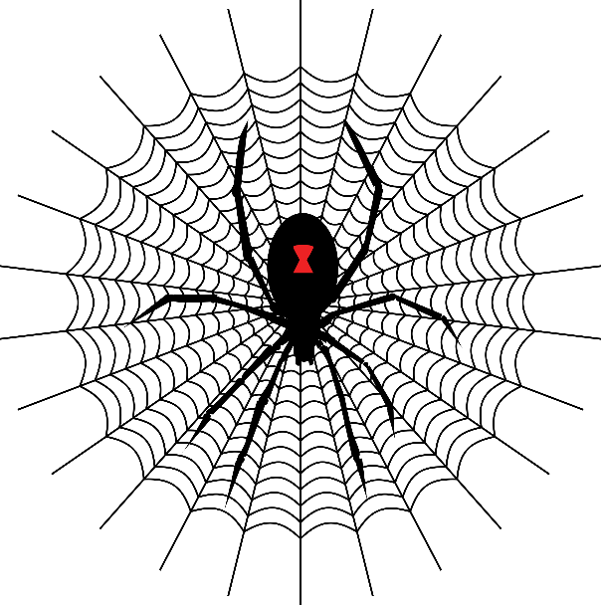
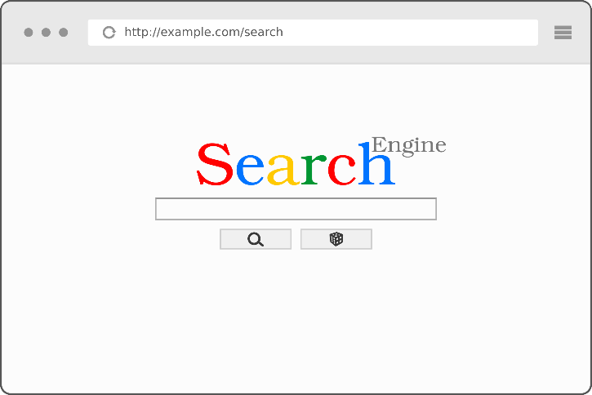
APPLICATION OF BFS
Web crawler in search engines

Slide 23
APPLICATION OF BFS
Web crawler in search engines
6
9
2
3
1
1
Root
4
5
7
8

Slide 24


APPLICATION OF BFS
Web crawler in search engines
Root

Slide 25
BFS AS A CRAWLER
...
Root

Slide 26
BFS AS A CRAWLER
Root

Slide 27
SOCIAL MEDIA
You

Slide 28
SOCIAL MEDIA
You

Slide 29
EXERCISE
C
K
J
A
F
H
I
G
B
L
E
D

